Slide 1
Dessert session
Dr prasanth

Slide 2
Middle aortic syndrome
Coarctation of the abdominal aorta, mid-aortic dysplastic syndrome.
Segmental narrowing of the abdominal or distal descending thoracic aorta secondary either to a congenital anomaly in the development of the abdominal aorta or to one of several acquired conditions.
0.5-2% of all the cases of aortic coarctation.
Male to female ratio is 3:1.1

Slide 3
The most common anatomic form - inter renal (19-52%)> supra-renal (11-40%)> infra-renal (19-25%) > diffuse(12%).
Stenosis of the renal arteries 60-90%.
Involvement of the coeliac and superior mesenteric arteries 20-40%
Congenital coarctation -due to incomplete fusion or overfusion of embryonic dorsal aortas during 4th week of gestation.
Another hypothesis implicates intra-uterine injury or infection, particularly rubella as the risk factor that precipitates aortic hypoplasia

Slide 4
Causes of MAS
Takayasu's or temporal arteritis (giant cell arteritis)
fibromuscular dysplasia.
Neurofibromatosis
retroperitoneal fibrosis(Ormond syndrome)
Mucopolysaccharidosis
foetal alcohol syndrome.
Williams syndrome
Alagille syndrome

Slide 5
SOV aneurysm into IVS: m mode findings
IVS dissection:
2D TTE in longitudinal view-a longitudinal defect (cystic space) of the IVS that is continuous with the aortic sinus aneurysm and extended into the muscular portion of IVS.
M-mode echo - two distinct echoes that moved in parallel, extending from the aorta to the IVS. The aneurysm enlarged during diastole and became smaller during systole.

Slide 7
Defibrillation

Slide 8
Paddle placement 4 Positions ---- Anterior-lateral > most convenient Anterior-posterior Anterior-left infrascapular Anterior-right infrascapular Anterior-lateral position ---- one – right of sternum below clavicle (2nd & 3rd ICS) other – left 4th or 5th ICS mid axillary line Reversing paddle markings “sternum & apex” does not affect defibrillation Paddles placed along axis of heart. AP- placement used in children with adult paddles.

Slide 9
Paddle position

Slide 10
Paddle Size
Adult – large paddles 10-13 cm diameter Pediatric – small paddles <1yr Infant <10kgs – 4.5cm Children >10kgs – 8cm

Slide 11
Paddle placement in patients with ICD/ pacemaker
There should not be any delay.
Avoid placing pads directly over the pulse generator.
The defibrillator paddle/pad should be placed on the chest wall ideally at least 8 cm from the generator position.
The anterior-posterior preferably and anterior-lateral paddle/pad placements on the chest are acceptable
Defibrillation: 2010 International Consensus on Cardiopulmonary
Resuscitation and Emergency Cardiovascular Care Science With Treatment Recommendations. Circulation.2010

Slide 12
Electromagnetic interference

Slide 13
EMI
Conducted EMI - when an electromagnetic source comes in direct contact with the body.
electrocautery and defibrillation
Radiated EMI - when the body is placed within an electromagnetic field.
no contact with the source is necessary.
MRI, positron emission tomography (PET) and radiation therapy.
results in alteration of device function for the duration the patient spends in the electromagnetic field

Slide 14
Electromagnetic interference can affect pacing:
1.The signal might be interpreted as cardiac in origin and temporarily inhibit or trigger output, depending on the pacing mode.
2.The signal might be interpreted as noise and temporarily cause reversion to an asynchronous pacing mode at a rate set by the manufacturer. This can lead to dangerous tachyarrhythmias as a result of an R on-T phenomenon.

Slide 15
3.The signal might be interpreted by the device as a programming signal, leading to inappropriate reprogramming.
4. A continuous train of electrical impulses (electrocautery), conducted down the lead can induce ventricular or atrial fibrillation.
5.High levels of current can pass through the device, down the lead, and into the endocardium, causing thermal burns at the lead–tissue interface. This can raise the pacing threshold.

Slide 16
EFFECTS OF EMI ON ICDs
EMI can mimic abnormal cardiac activity. If a signal is interpreted by the ICD as VT or VF, it can respond inappropriately by initiating antitachycardia pacing or delivering a countershock.
If the signal is interpreted as noise, the device may respond by suspending arrhythmia detection, leaving the patient unprotected.

Slide 17
Precautions to be taken while using electrocautery
When possible, bipolar electrocautery should be used.
If at all monopolar electrocautery is used, the cautery current pathway should be perpendicular to the pacemaker’s lead system when possible. This is done by manipulating the placement of the grounding plate.

Slide 18
The grounding plate should be placed so that the current flows away from the pulse generator and the distance between it and the active tip of the electrocautery should be as small as possible.
If it is impossible to place the pacemaker in asynchronous mode, the cautery current should be applied for no more than 1 second at a time, allowing at least 10 seconds for the device to function properly.

Slide 19
Harmonic scalpel
using an ultrasonically activated scalpel as an alternative to electrocautery in patients with implanted cardiac devices.
The scalpel thermally transfers heat to the tissue without electrical current passing through the patient.
More recently it has been used to assist in pacemaker replacements and implants.

Slide 20
Differentiation of true/false lumen by TEE

Slide 21
 | TRUE LUMEN | FALSE LUMEN
SIZE | smaller | larger
SHAPE | Regular- oval/round | Irregular
PULASATION | Systolic expasion | Systolic compression
FLOW DIRECTION | antegrade | Reduced antegrade/retrograde
LOCATION- AORTIC ARCH | Inner | Outer
THROMBUS/ sworling homogenous echoes | Rare | Frequent
SIGN OF SLOW FLOW | Rare | Frequent
COMMUNICATION FLOW | True to false lumen
FIBRINOUS TAGS OF TISSUE | absent | Often present

Slide 22
Mechanisms of AR in patients with aortic dissection

Slide 23
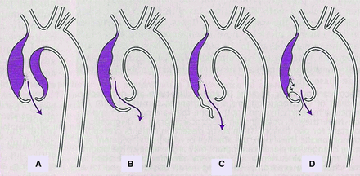

Slide 24
AP Window classification

Slide 25
Aorto pulmonary window
0.2%-0.6% of all congenital heart diseases.
Mori et al CLASSIFICATION:
Type I or proximal (70%)
the defect is circular, located in a zone equidistant between the sigmoid valve plane and the pulmonary bifurcation.
Type II or distal (25%)
spiral form, it affects the trunk and origin of the right pulmonary artery
Type III (5%)
complete defect of the aortopulmonary septum

Slide 26
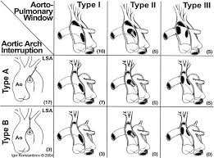
Common associations:
Ao AI Type A
PDA
VSD
TOF
Coronary anomalies

Slide 27
Truncus arteriosus surgery

Slide 28
Truncus arteriosus
3% of all congenital heart defects
Common associations:
ventricular septal defect (VSD)
TrV dysplasia or dysfunction
Aortic arch and coronary artery anomalies.
DiGeorge syndrome- 20%

Slide 29
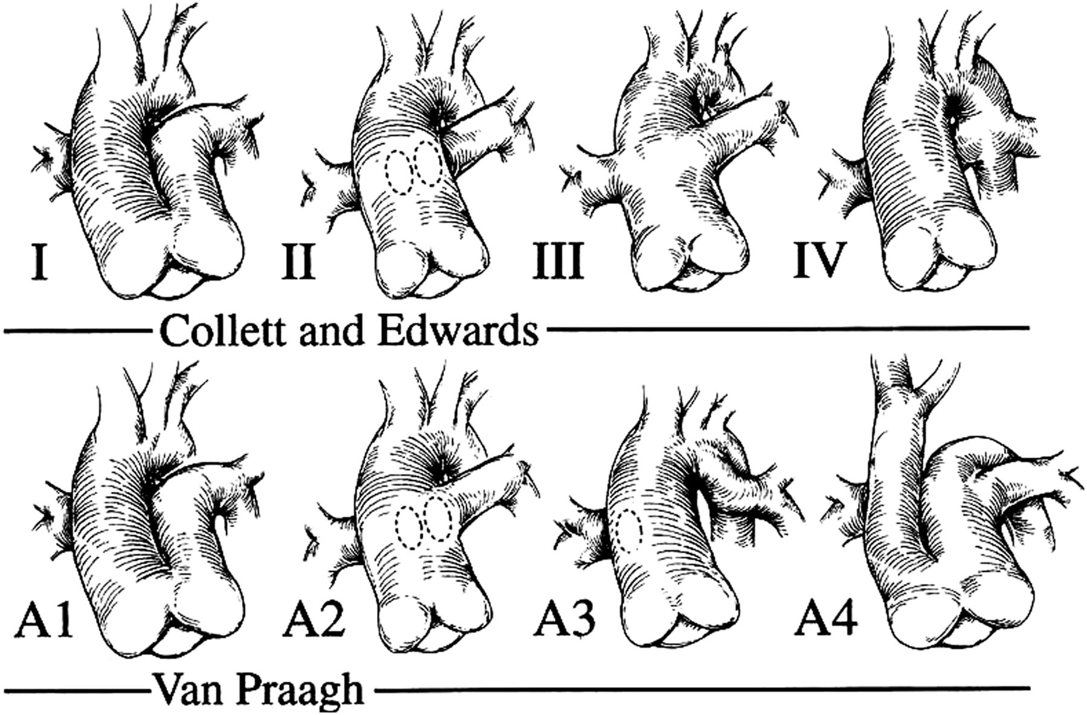
Major classification systems for truncus arteriosus reproduced from [25] with permission from Elsevier.
© The Author 2012. Published by Oxford University Press on behalf of the European Association for Cardio-thoracic Surgery. All rights reserved
Notes:
Major classification systems for truncus arteriosus reproduced from [25] with permission from Elsevier.

Slide 30
TECHNIQUE OF OPERATION
The surgical approach is by median sternotomy
Both PAs are dissected free, mobilized and encircled.
The TA is opened transversely in the anterior wall .
The orifices of coronary arteries and PAs are identified.
PAs are detached from the common arterial trunk and mobilized extensively into both hili.
Right ventriculotomy incision is made and excessive muscle is removed from the opening.
The VSD is identified and closed with a xenopericardial patch using a continuous suture.
The aortic defect can be repaired with a xenopericardial patch.
RV-to-PA anastomosis can be completed anteriorly by a valved/valveless conduit.

Slide 31
Truncus surgery

Slide 32
TAPVC surgery

Slide 33
The principle of operative repair
To establish an unobstructed communication between the pulmonary venous confluence and the left atrium
To interrupt the connections with the systemic venous circulation
To close the atrial septal defect.
The specific repair is dependent on the type of anomalous connection.
Essential to successful repair is the proper identification of all 4 pulmonary veins and their anomalous connection prior to repair

Slide 34
Supracardiac TAPVC
Retract the ascending aorta and SVC laterally to expose the pulmonary venous confluence.
The vertical vein can be identified and ligated outside the pericardium at the level of the innominate vein.
The entry of the LUPV should also be carefully identified to avoid inadvertent ligation.
A transverse incision is made in the pulmonary venous confluence and a parallel incision is placed in the dome of the LA beginning at the base of the LAA.
A right atriotomy is made to close the ASD.

Slide 35
Supracardiac TAPVC

Slide 36
Cardiac TAPVC
A right atriotomy is performed with identification of the ASD and the orifice of the coronary sinus.
The roof of the coronary sinus is excised into the LA.
A patch of pericardium or prosthetic material -placed to close the enlarged ASD, channelling the pulmonary venous return into the LA.
Care needs to be taken while suturing the patch in CS area due to close proximity of the conduction system.

Slide 37
Cardiac TAPVC

Slide 38
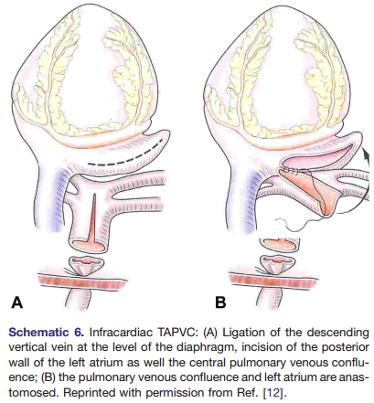
Infracardiac

Slide 39
Recurrent pulmonary venous obstruction
Isolated narrowing of the anastomosis can be repaired with revision or patch augmentation of the anastomosis.
Obstruction of the individual pulmonary venous ostia is a greater challenge.
The obstruction may initially appear to be limited to the ostium,but progressive narrowing along the entire length of the vein into the hilum of the lung will occur with time.
A new approach- a sutureless technique utilizing in situ pericardium to create a neo-atrium.
Repair involves wide unroofing of the narrowed portion of each involved pulmonary vein from the left atrial anastomosis to the hilum

Slide 40
Recurrent pulmonary venous obstruction

Slide 41
Cardiac manifestations of Kawasaki Disease

Slide 42
Cardiac manifestations
Myocarditis
Pericarditis
Congestive cardiac failure
Pericardial effusion
Coronary dilatation
Valvular regurgitations

Slide 43
Heart and liver

Slide 44
Cardiac hepatopathy
Severe congestive heart failure is associated with two distinct forms of liver dysfunction
1.Congestive hepatopathy:
liver dysfunction due to passive congestion, or backward failure
2.Hypoxic hepatitis:
acute hepatocellular necrosis caused by impaired hepatic perfusion or due to forward failure

Slide 45
Macrocirculation of liver
The liver has a rich dual blood supply derived from both the portal and systemic vascular compartments.
The portal vein contributes 2/3rd of hepatic blood flow and the hepatic artery is responsible for the remaining 1/3rd .
To maintain constant sinusoidal pressure to the hepatic beds, the liver employs an autoregulatory mechanism.
A decrease in blood flow via the portal vein is matched by a compensatory dilation of the hepatic artery. But the reverse is not true.

Slide 46
Microcirculation
The histological unit of the liver is the lobule.
The functional unit of the liver is the acinus .
The classical lobule is hexagonal in shape, bounded by the portal triads with the central vein at the center.
The acinus is diamond shaped and has at its center a line connecting two portal triads.
The acinus is divided into zone 1 (periportal), zone 2 (transition), and zone 3 (centrilobular) according to the direction of flow of oxygen- and nutrient-rich blood.
Zone 1 closest to the portal triad to zone 3 surrounding the terminal hepatic vein.

Slide 47
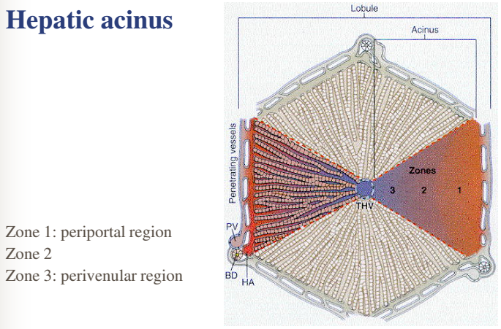

Slide 48
CONGESTIVE HEPATOPATHY
In the setting of right heart failure or any cause of increased central venous pressure
Zone 3 hepatocytes are the most susceptible to damage induced by passive congestion .
The increased hydrostatic pressure produces sinusoidal edema and hemorrhage, which eventually compromises oxygenation .
Fibrosis of cardiac hepatopathy is predominantly around the central hepatic veins with relative sparing of the portal tracts (“reverse lobulation”).
The stage of congestive heart failure does not seem to correlate well with the extent of hepatic fibrosis and cirrhosis.

Slide 49
“nutmeg appearance”- congested liver
Chronic passive congestion of the central veins with hemorrhage and necrosis in zone 3.
Red cells pool and distend the sinusoids around the central vein.
These regions develop a darker red-violet color, in contrast to the surrounding tan liver parenchyma.

Slide 50
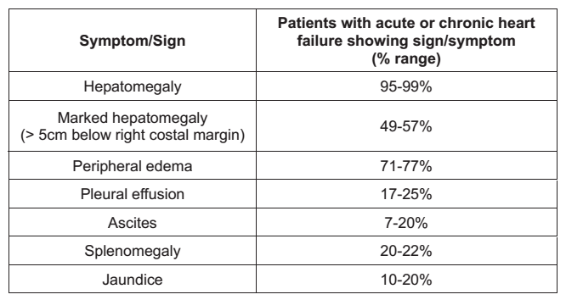
Clinical Features
Hepatomegaly is the most common manifestation.
A mild, dull, right upper quadrant pain is often present
Lack of stigmatas of portal hypertension- absent dilated veins, esophageal varices, splenomegaly

Slide 51
Ascites
It must be noted that the ascites is a result of right-sided heart failure and not intrinsic liver dysfunction.
Although the SAAG is > 1.1 g/dL, the ascitic fluid protein level is characteristically high, often >2.5 g/dL.
This high protein content is an indication of the preserved synthetic function of the liver, a finding unique to cardiac cirrhosis.
The sinusoidal hypertension with disruption of fenestrae ultimately allows for exudation of a protein rich fluid.
Ascitic fluid Lactate dehydrogenase (LDH) and red cell counts- tend to be higher in cardiac cirrhosis.

Slide 52
Abdominal imaging
Liver ultrasonography
shows hepatomegaly with a homogeneous increase in echogenicity throughout the liver and dilation of the suprahepatic veins and IVC.
CT and MRI
early reflux of contrast material from the RA to the IVC, and a heterogeneous, mottled-appearing liver parenchyma, often referred to as a mosaic pattern.
Histologically
Relative sparing of the portal tracts from fibrosis – a distinguishing factor of cardiac cirrhosis compared to other etiologies of cirrhosis

Slide 53
LFT
Elevated serum bilirubin is a common finding in cardiac hepatopathy, except perhaps in constrictive pericarditis.
Usually <3 mg/dL and mostly unconjugated.
Clinical jaundice is uncommon.
Increases in the serum bilirubin have been shown to correlate with the severity of RAP and passive congestion
The causes of Hyperbilirubinemia –multifactorial
hepatocellular dysfunction.
obstruction secondary to passive congestion
pressure atrophy of the canaliculi
pulmonary infarction.
bile thrombi.
Hemolysis
Medications
S.Albumin and PT remain normal most of the time/ mildly deranged

Slide 54
Prognosis
Hepatic function typically remains stable, even when cardiac cirrhosis and ascites ensue.
Fulminant liver failure, hepatic encephalopathy - restricted to those with superimposed ischemic liver injury rather than passive congestion alone.

Slide 55
Hypoxic hepatitis
Hypoxic hepatitis is defined as an acute and reversible significant elevation of serum AST and ALT levels to more than 20 times the upper limit of normal in the absence of known acute hepatitis or hepatocellular injury and with an appropriate clinical picture specifically involving acute circulatory, cardiac, or respiratory failure
The most common cause of acute liver injury.
“shock liver” , “ischemic hepatitis”

Slide 56
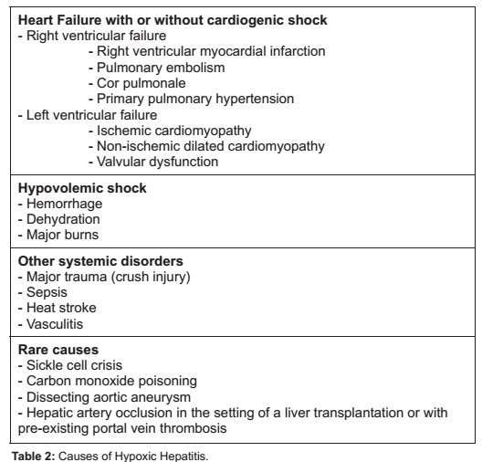

Slide 57
Histopathology
Classically, “ischemic hepatitis” –characterised by
centrilobular necrosis
loss of hepatocytes
sinusoidal congestion with erythrocyte extravasation.
characteristically unremarkable inflammatory infiltrate.

Slide 58
Clinical features
Patients with hypoxic hepatitis tend to be older, male, acutely ill in the intensive care unit.
Signs and symptoms of acute liver injury are usually absent
Acute fulminant hepatic failure, although rare, is more likely to occur in the presence of underlying congestive heart failure or cirrhosis.
more commonly diagnosed incidentally with routine LFT done 2-24 hours after an episode of systemic hypotension.
LFT of hypoxic hepatitis are consistent with a hepatocellular pattern

Slide 59
AST and LDH rising most sharply and peaking in the first 12-48 hrs, while the rise and peak ALT is not as dramatic.
The aminotransferase levels fall by greater than 50% within 72 hours of resolution of the underlying insult and return to normal within 7-10 days.
Increases in LDH level tend to be massive and ALT/LDH ratio of <1.5 distinguishes ischemic injury from other forms of acute hepatitis
The integrity of hepatic synthetic function is compromised in hypoxic hepatitis, as determined by PT/INR
Elevated lactate
Bilirubin may be mildly elevated
Increase in creatinine level from ATN

Slide 60
The differential diagnosis
Acute viral hepatitis
Autoimmune hepatitis
Drug-induced liver injury (e.g. acetaminophen)
Acute Wilson’s disease
Acute vascular thrombosis e.g. hepatic artery and portal vein thrombosis.

Slide 61
Cirrhotic cardiomyopathy
Definition
A cardiac dysfunction in patients with cirrhosis characterised by impaired contractile responsiveness to stress and/or altered diastolic relaxation with electrophysiological abnormalities in the absence of other known cardiac disease
The prevalence is 40 to 50% in patients with cirrhosis.
The development of cirrhotic cardiomyopathy - independent of the aetiology of liver disease.
There is no specific therapy but cirrhotic cardiomyopathy is almost completely reversible after liver transplantation.

Slide 62
Cirrhotic cardiomyopathy

Slide 63
Features of cirrhotic cardiomyopathy
Structural changes
LVH and LA dilatation in more than 1/3rd cases
Due to combination of mechanical overload due to hyperdynamic circulation and neurohormonal activation.
Impaired cardiac response to exercise
The presence of chronotropic incompetence during exercise in cirrhotic patients with ascites, who reached 65% of their maximal predicted heart rate.
Inability to increase LVEF during exercise despite normal or even higher LVEF at rest compared to normal controls.
Overall, the increase of cardiac output during exercise was severely impaired in these patients.
Acute exacerbation of anaemia, sepsis, or creation of TIPS are known to precipitate HF in patients with cirrhotic cardiomyopathy.
Wong F et al. The cardiac response to exercise in cirrhosis. Gut.2001

Slide 64
Impaired cardiac response to exercise
Three main mechanisms.
1.There is a down-regulation of β-adrenergic receptors density in the cardiomyocytes with impaired β-adrenergic signalling.
2.Reduced protein expression of L-type calcium channels with reduced calcium influx results in impaired cardiac contractility in response to pharmacological stress.
3. Increased cytokines, nitric oxide, carbon monoxide and endocannabinoids, impair intracellular signalling for contraction.

Slide 65
Impaired cardiac response to exercise -mechanisms

Slide 66
Diastolic dysfunction
Prevalence is between 45 and 56%
Due to a combination of myocardial hypertrophy, fibrosis due to increased aldosterone levels and subendothelial oedema.
Prolonged QT interval
Prevalence of more than 60% in advanced cirrhosis.
decrease in K+ currents in ventricular myocytes.
QT interval revert to normal with improved liver function, after liver transplantation.
Propranolol and nadolol have been shown to reduce the QT interval prolongation
Natriuretic peptides
Both B-type natriuretic peptide (BNP) and N-terminal proBNP (NT-proBNP) have been shown to be significantly increased.
secondary to increased cardiac production.
associated with the severity of both cirrhosis and cardiac dysfunction

Slide 67
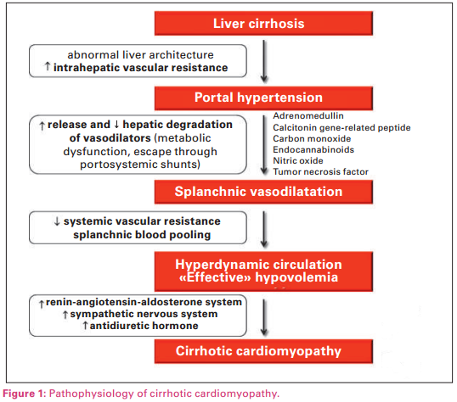

Slide 68
Pathophysiology in cirrhotic cardiomyopathy

Slide 69
Conditions affecting both the liver and the heart

Slide 70
Infections
Multiorgan failure in relation to sepsis
Hepatitis C virus infection
HIV is known to cause hepatitis, hepatic granulomas, myocarditis and HIV-associated cardiomyopathy.
Dengue fever - hepatic necroses combined with myocarditis.
Malaria -massive hepatic involvement lead to cardiac failure

Slide 71
Inflammatory disorders
Systemic lupus erythematosus (SLE)
Sarcoidosis .
systemic disease characterized by non-caseating granulomas.
most frequent aetiology of hepatic granuloma.
Liver is the third most common organ involved.

Slide 72
Systemic disorders
Haemochromatosis
Amyloidosis (AL & TTR)
Wilsons disease

Slide 73
Alcoholic heart muscle and liver disease
Alcohol abuse can harm both the liver and the heart
Chronic (10– 12 years) consumption of amounts of ethanol as low as 25 g/day in males and 12 g/day in females is associated with an increased risk of cirrhosis.
>90 g/day for at least 5 years appear to be needed for inducing detectable changes in cardiac structure and function.
A moderate alcohol consumption (about 25 g/day) may protect against cardiovascular events.
In any case, there is a correlation between development of alcoholic heart muscle disease and alcoholic cirrhosis.

